Slide 1
Revora, NewsTv19 & Task-Ops
Industry Mentor:
Mr. Kanwar Pal Singh Rathore Singh
TechBizSolutions
Internal Faculty Mentor:
Dr. Preeti Gupta
School of Technology Management & Engineering
NMIMS, Navi Mumbai

Slide 2
Table of Content
Sr. No. | Topic | Slide No.
1 | Internship Overview | 3
2 | Objective of the Project | 3
3 | Abstract — TaskOps and NewsTV19 | 4
4 | Abstract — Revora | 5
5 | Industry Relevance / Motivation | 6
6 | Problem Statement | 7
7 | System Architecture | 8
8 | Project Workflow | 9
9 | Hardware and Software Used | 10
10 | Methodology | 11
11 | TaskOps Admin Dashboard Evidence | 12
12 | TaskOps Screenshots and Features | 13
13 | NewsTV19 Screenshots and Features | 14
14 | Revora Screenshots and Features | 15
15 | Revora AI Pricing Assistant | 16
16 | CSV Upload and Validation Pipeline | 17
17 | Screenshots of Results | 18
18 | Result and Analysis | 19
19 | Future Work | 20
20 | Conclusions | 21
21 | References | 22

Slide 3

Internship Overview
• Internship at Delta The Innovators
• Working on TV19 News platform
• Role: MERN Stack Developer Intern
• Duration: 5th Jan 2026 – 30th April 2026
Objective of the Project
• Optimize a real-time news aggregation engine to handle high-volume data from 20+ categories.
• Develop production-level proxy servers using Express.js and TypeScript for multi-source RSS feed parsing.
• Implement automated metadata enrichment and OG image scraping to ensure high-quality content delivery.

Slide 4
Abstract — Foundational & Collaborative Projects
Project 1: TaskOps (Independent Full-Stack Project)
Project Details: An enterprise-grade project management and real-time collaboration platform built on the MERN stack (MongoDB, Express, React, Node.js). It features a live Kanban board, real-time sync, and an interactive analytics suite.
Role & Tasks: Served as the Lead Full-Stack Developer. Independently architected the three-tier Role-Based Access Control (RBAC), integrated Socket.io for live notifications, and implemented a drag-and-drop system using @dnd-kit.
Project 2: NewsTV19 (Company Product Contribution)
Project Details: A production-scale news aggregation web application that consolidates live feeds from 20+ global news publishers (BBC, TOI, etc.) across multiple categories.
Role & Tasks: Acted as a Backend & Integration Specialist. Developed a custom Express.js RSS Proxy Server with a deduplication engine. Built an asynchronous OG-metadata scraper to automatically enrich news articles with high-resolution images.

Slide 5
Abstract — Foundational & Collaborative Projects
Project 3: Revora (Core Product: Business Intelligence)
Project Details: A high-complexity Pricing & Demand Intelligence platform designed for data-driven decision-making. It enables businesses to simulate market scenarios and receive automated pricing recommendations.
Role & Tasks: Worked as a Core Full-Stack Developer. Engineered a Demand Intelligence Engine to model price elasticity and a Bulk Data Pipeline for high- volume CSV ingestion using stream-based parsing.
AI Integration: Successfully integrated a local Mistral LLM as a conversational pricing assistant, implementing a state-machine architecture to ensure grounded and reliable business guidance.

Slide 6
Industry Relevance / Motivation
Revora is positioned as decision support for real business pricing, not blind automation.
1
2
3
4
Foundation
TaskOps
NewsTv19
Revora
Node, Express, MongoDB, auth
RBAC, task boards, real-time workflows
RSS ingestion, search, production codebase
pricing intelligence and decision quality
Angle | How Revora answers it
Business need | Manual pricing needs margin, demand, inventory, and competitor context.
Practical applicability | Retail catalog managers can import CSVs and review safe ranges before acting.
Market fit | Small teams want BI-style guidance without requiring a data-science operator.
Project motivation | Convert internship backend/frontend learning into one analytics product.
The system keeps a human in control: it recommends, explains, warns, and exports evidence.

Slide 7
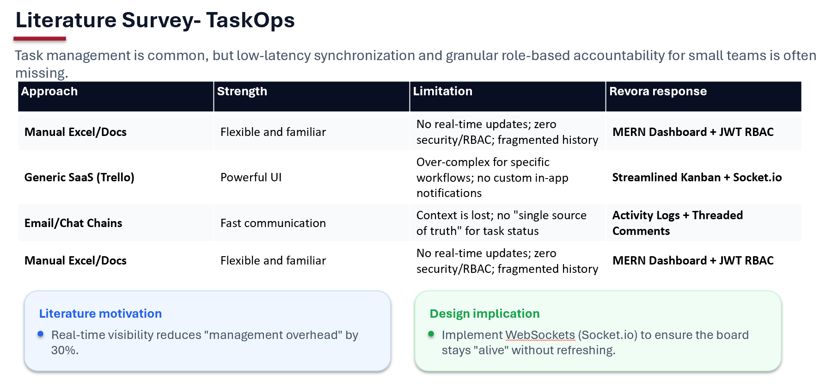

Slide 8
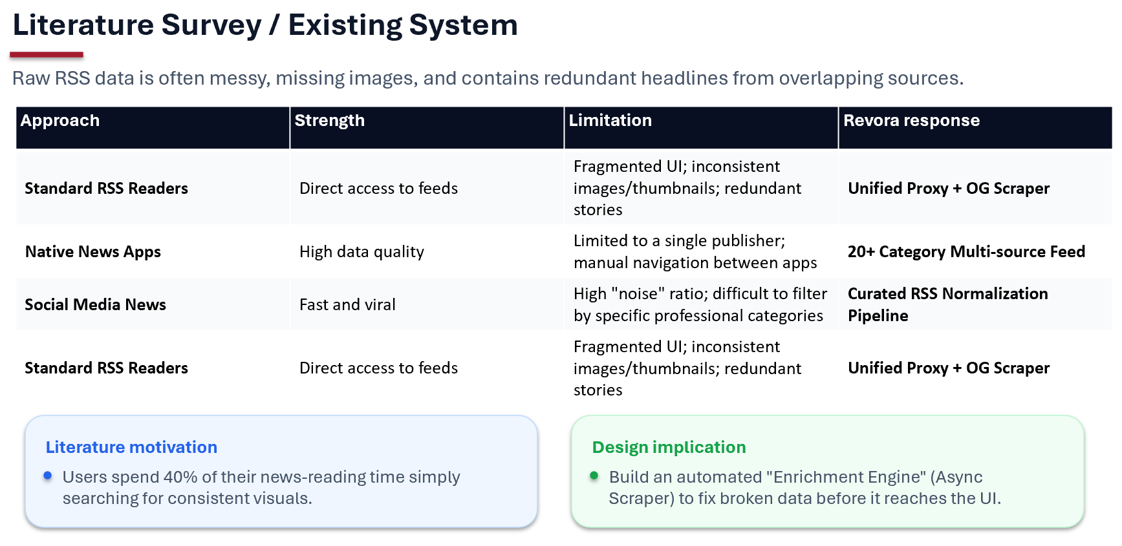

Slide 9
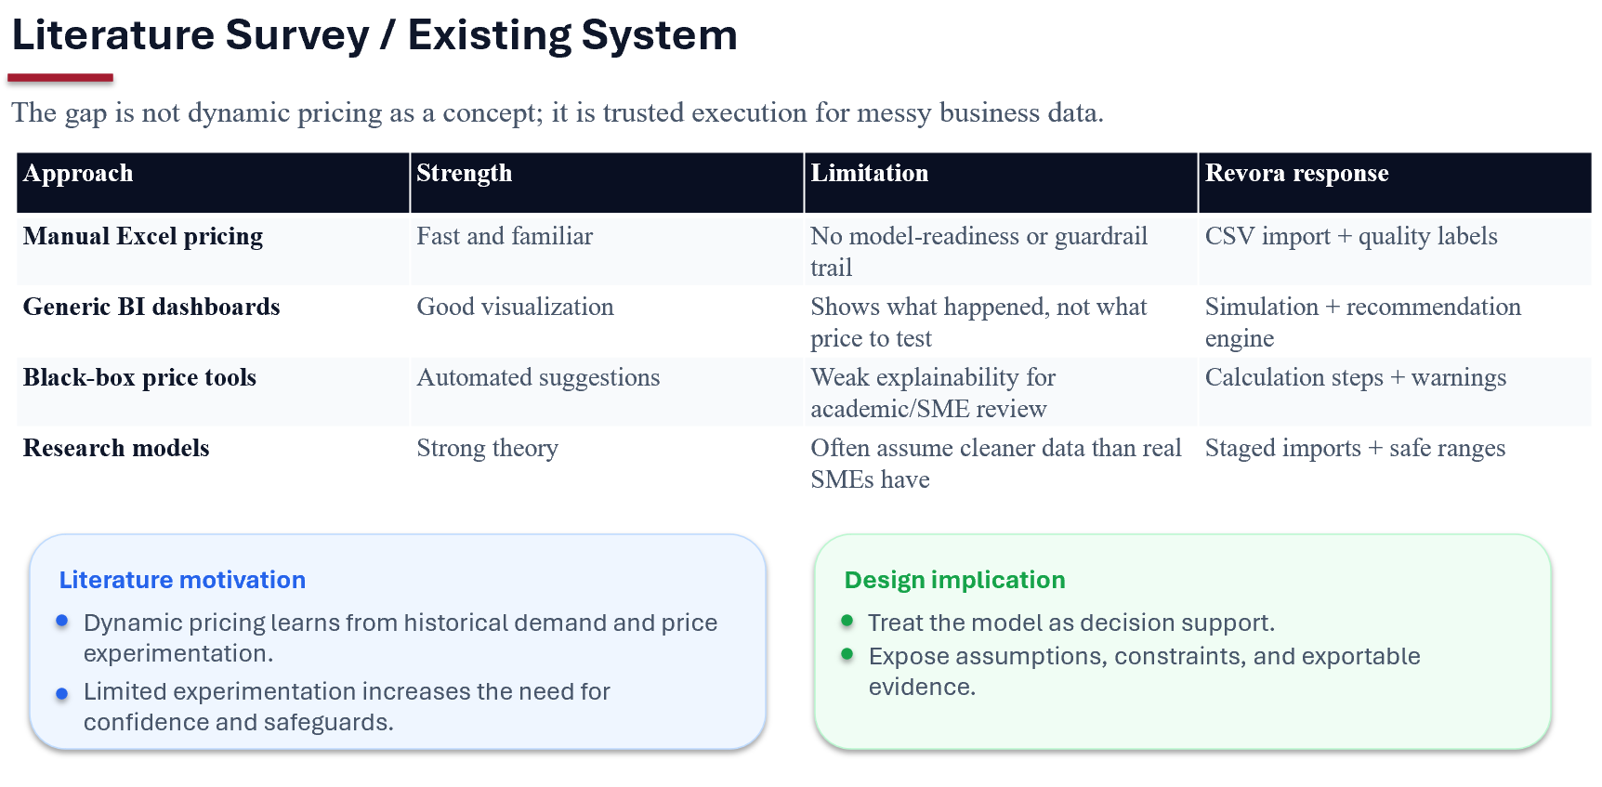

Slide 10
Hardware and Software used
Hardware:
Intel Core i5
16GB RAM
256GB SSD
Windows 11 OS
Software (Technologies & Tools):
Languages: JavaScript (ES6+), TypeScript, Python, HTML5, CSS3
Frontend: React.js, Vite, Tailwind CSS v4, Bootstrap 5
Backend: Node.js, Express.js, Flask
Database: MongoDB, Mongoose ODM
Real-time: Socket.io
AI/ML: Mistral LLM, Pandas, NumPy
Cloud & DevOps: Docker, AWS S3
Security: JSON Web Tokens (JWT), Bcrypt
Analytics: Recharts
Development Tools: VS Code, Postman, Git, GitHub, npm, pip

Slide 11
Methodology
Requirement Analysis & Planning: Defined project goals, user roles (RBAC), and technical scopes for TaskOps, NewsTV19, and Revora.
System Architecture Design: Designed the MERN stack structure, MongoDB schemas, and API endpoints. Planned the integration of external services like AWS S3 and RSS proxies.
Component-Based Development: Developed modular, reusable UI components using React & Vite and built scalable RESTful APIs with Node.js & Express.
Feature Integration & AI Implementation: Integrated real-time sync with Socket.io, data enrichment with Async Scrapers, and decision intelligence with Mistral LLM.
Testing & Refinement: Conducted performance audits, optimized database queries, and refined the UI using Tailwind CSS v4.
Deployment & Documentation: Containerized applications using Docker and deployed the backend to Fly.io, followed by drafting technical interim reports.

Slide 12
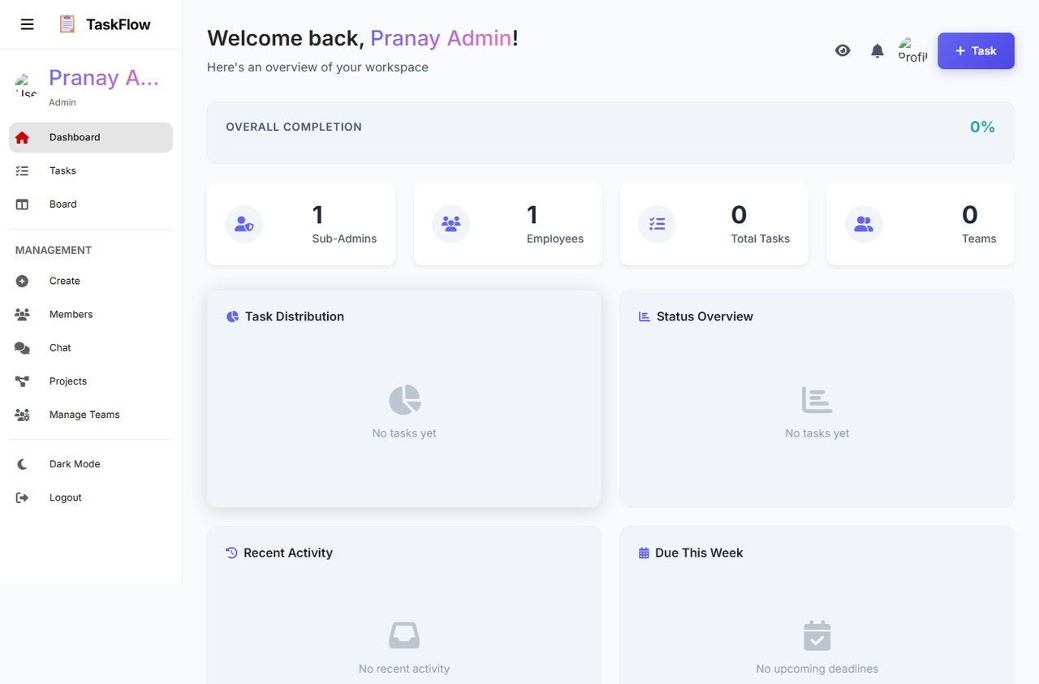
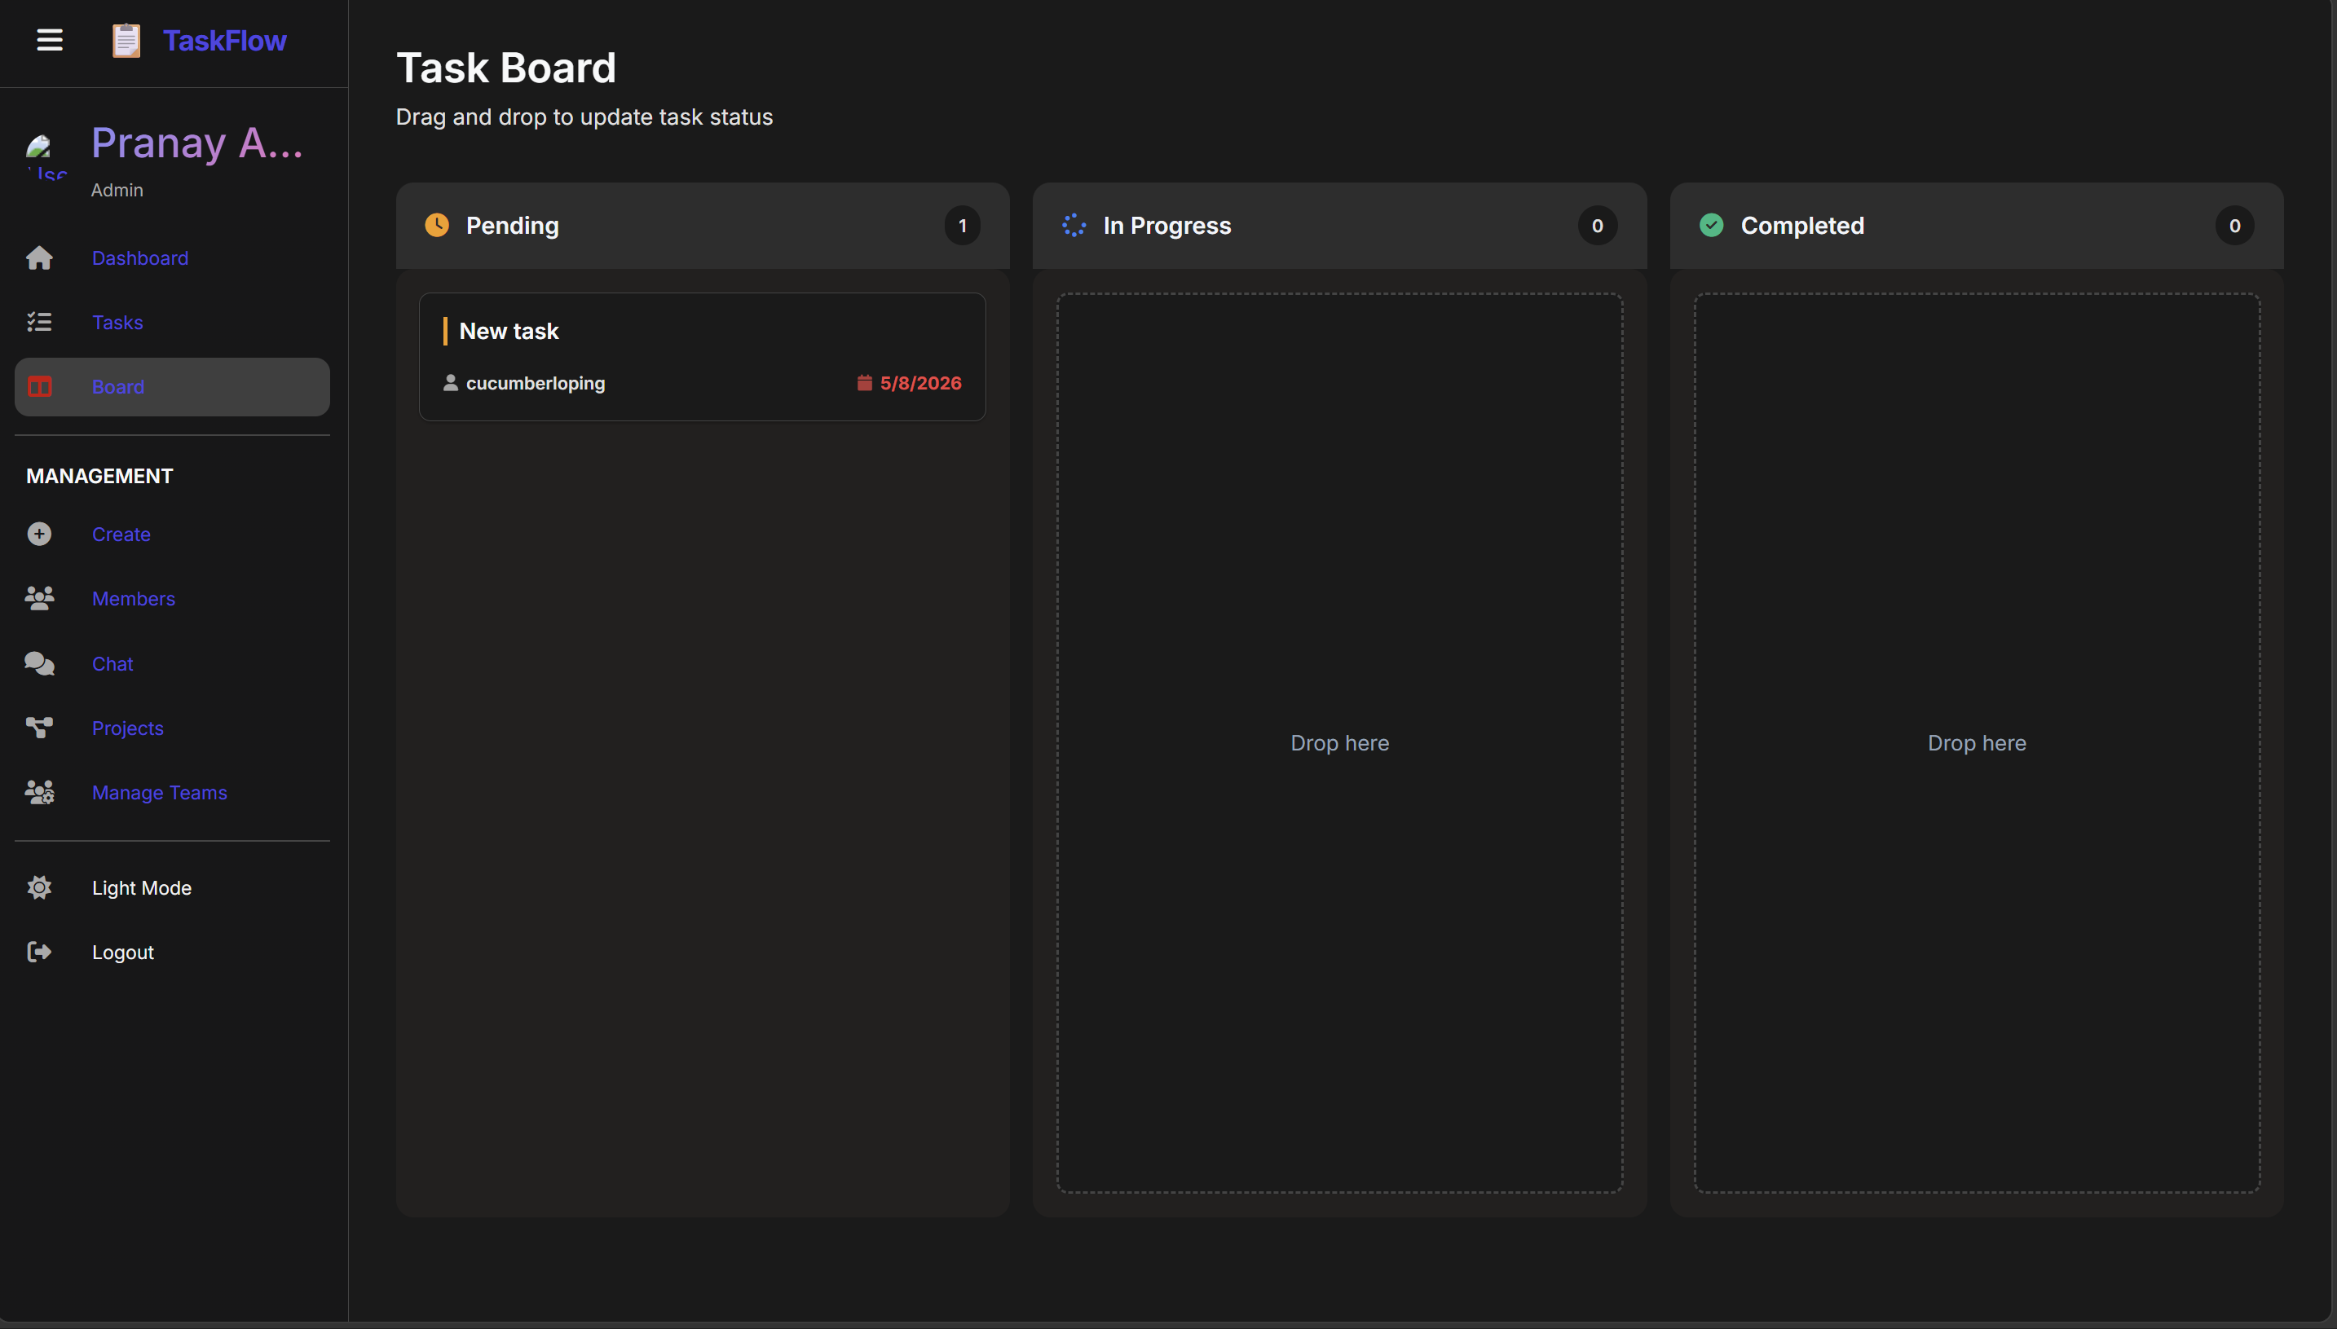
TaskOps admin dashboard evidence
Task Board

Slide 13
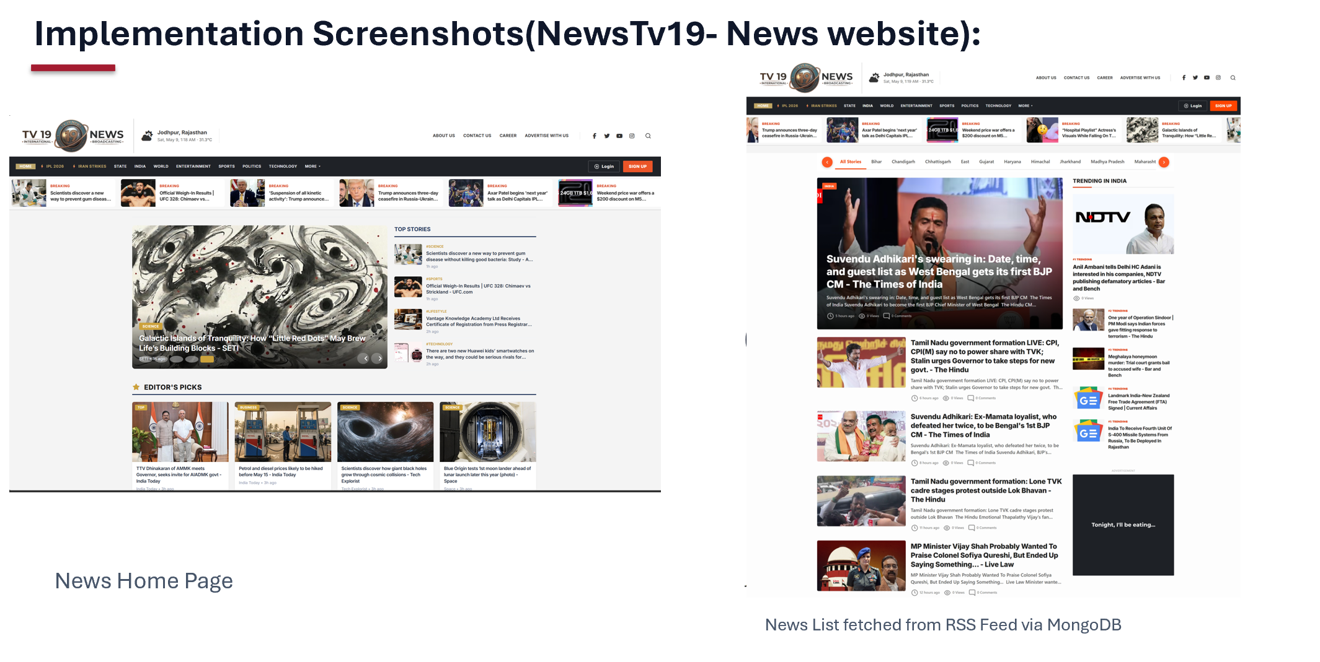

Slide 14
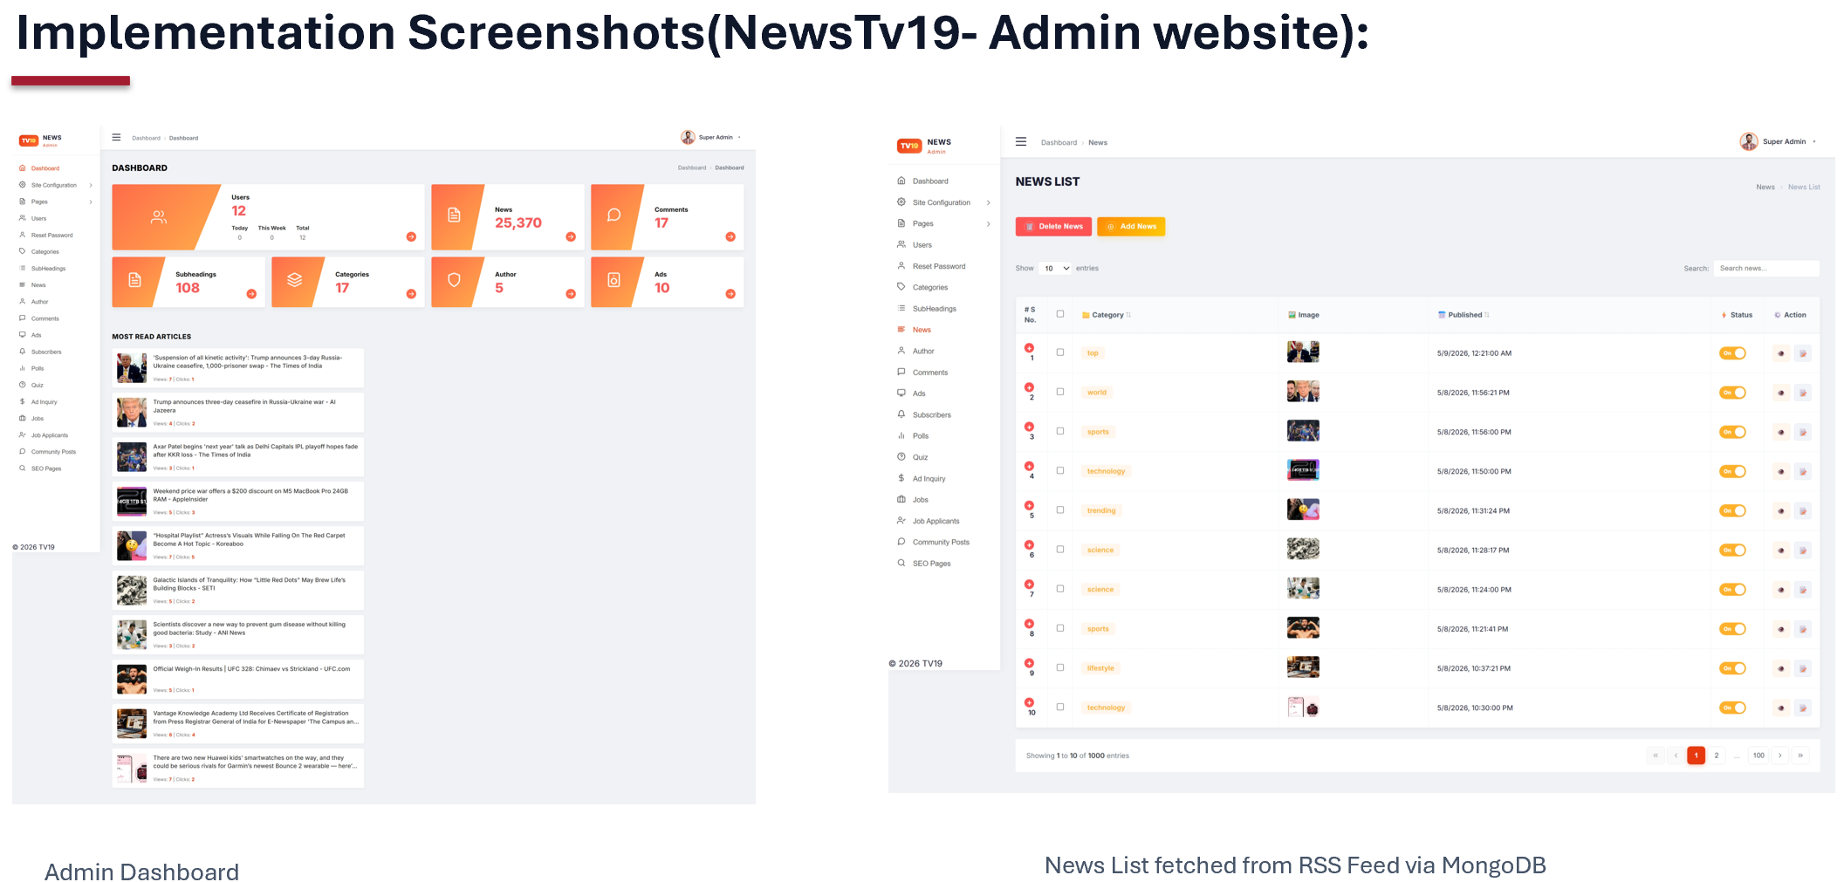

Slide 16
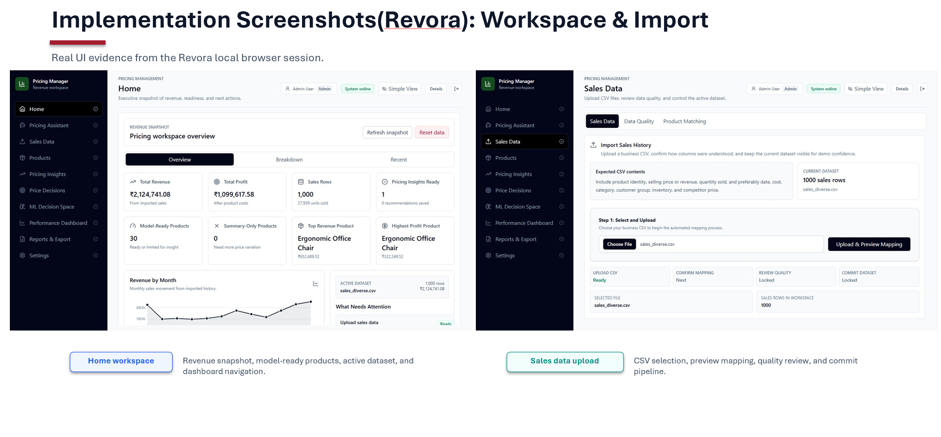

Slide 17
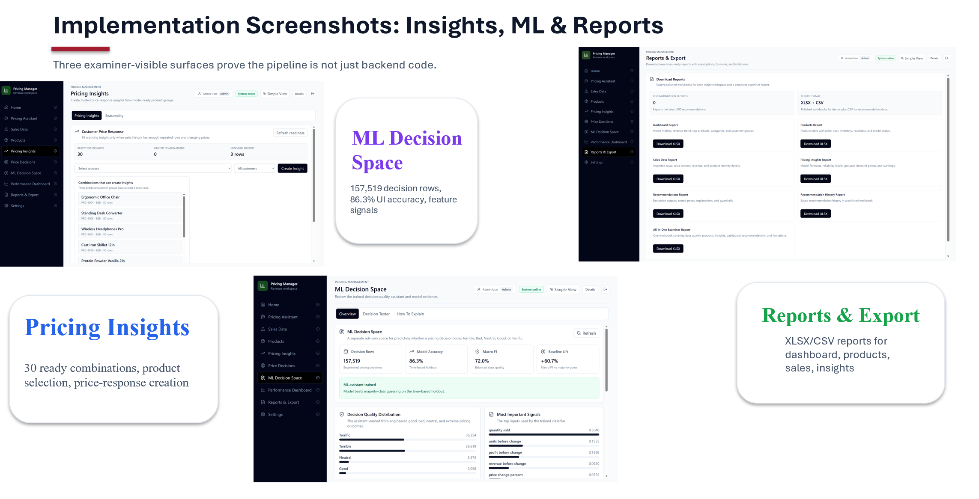

Slide 18
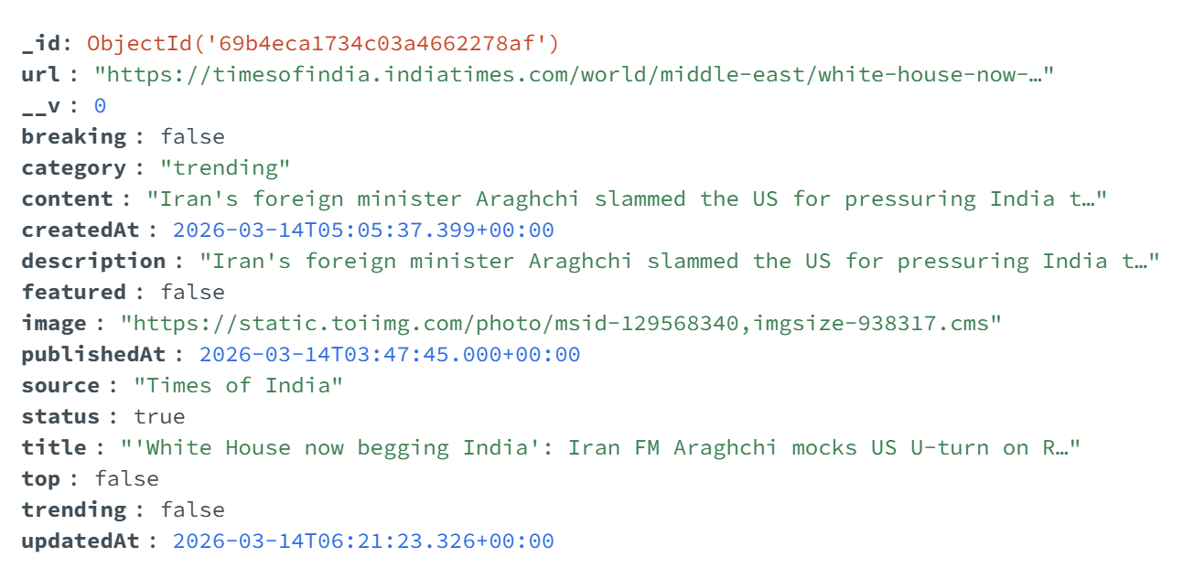
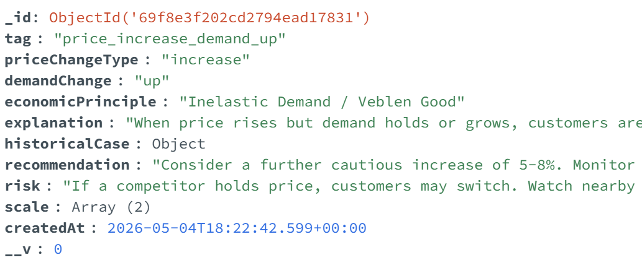
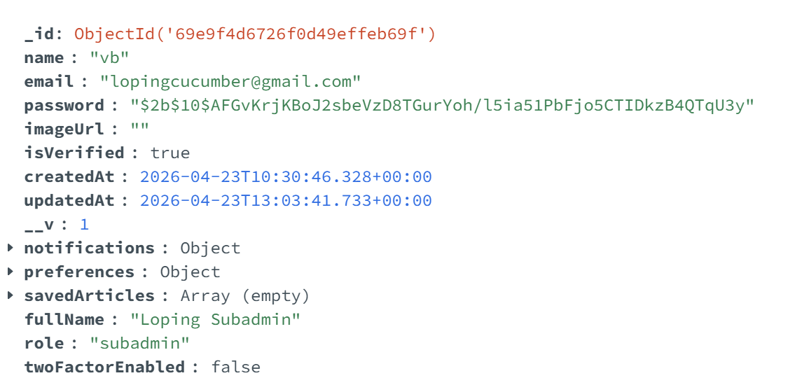
Screenshots of Results
NewsTv19
Revora
TaskOps

Slide 19
Result and Analysis
TaskOps (Project Efficiency):
Successfully implemented a single source of truth for team tasks, reducing status-check meetings by providing real-time visibility.
Achieved <200ms latency for task updates and notifications using Socket.io.
NewsTV19 (Data Quality):
95%+ Image Coverage: The Async OG-Scraper successfully enriched articles that lacked thumbnails in raw RSS feeds.
30% Data Deduplication: Effectively filtered redundant headlines across 20+ overlapping global news sources.
Revora (Intelligence Engine):
Automated Guardrails: Successfully implemented a "Quality Gate" that flags 100% of invalid sales data (missing SKUs or negative margins) before analysis.
High-Volume Processing: Stream-based CSV ingestion handled 1000+ records with minimal memory overhead (<100MB RAM usage).

Slide 20
Future Work
1. Revora App (Intelligence Platform)
Predictive Forecasting: Implement time-series analysis to forecast future sales trends and seasonal demand.
Competitor Tracking: Build a real-time monitoring module to track competitor price changes automatically.
Redis Caching: Integrate Redis to optimize the performance of complex analytical and simulation queries.
2. NewsTV19 & TaskOps
Personalization: Add user profiles to NewsTV19 for personalized news feeds and bookmarks.
Advanced Analytics: Introduce burndown charts and project-level velocity tracking in TaskOps.
Mobile Audit: Perform a comprehensive mobile responsiveness audit to ensure a seamless experience across all devices.
3. System-Wide Improvements
Automated Testing: Expand unit and integration test coverage using Jest and Supertest.
CI/CD Pipeline: Set up GitHub Actions for automated testing and deployment to streamline the production release process.

Slide 21
Conclusions
Successful Project Delivery: Completed three distinct full-stack applications—TaskOps, NewsTV19, and Revora—demonstrating proficiency across the entire software development lifecycle.
Technical Mastery: Gained deep expertise in the MERN stack, transitioning from independent project creation to contributing to production-ready company codebases.
Bridging the Gap: Effectively translated complex business requirements into technical solutions, specifically in real-time communication, data enrichment, and AI-driven decision support.
Professional Growth: Developed critical industry skills, including version control (Git), Docker containerization, and agile iterative development.

Slide 22
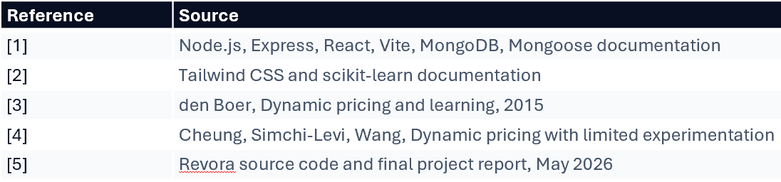
References

